Slide 1
Language processing

Slide 2
On text encoding
Computers represent characters via character encodings. Basically, a mapping from a binary representation to a character symbol value.
There's many character encodings and most often our text system auto detects them.
On a computer, the program has to interpret the character code and display it in a way that we want.
ASCII represents characters as 7 bits, (unicode)
UTF-8, UTF-16 and UTF-32 represent characters as 8, 16, and 32 bits.
Of course the greater the bit representation, the larger the character set that can be represented.
ASCII contains only the usual keyboard characters whereas Unicode contains much more.
Here's https://docs.python.org/3/howto/unicode.html#the-unicode-type some info about python unicode.
python's default character encoding is UTF-8. So strings automatically allow UTF-8 characters

Slide 3
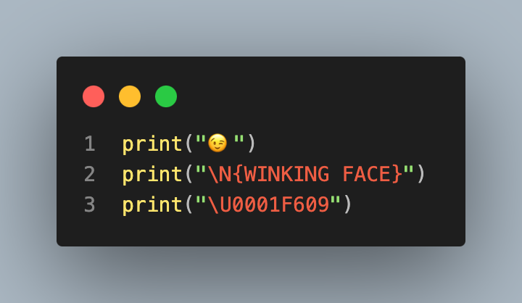
Using UTF in python
😉
😉
😉

Slide 4
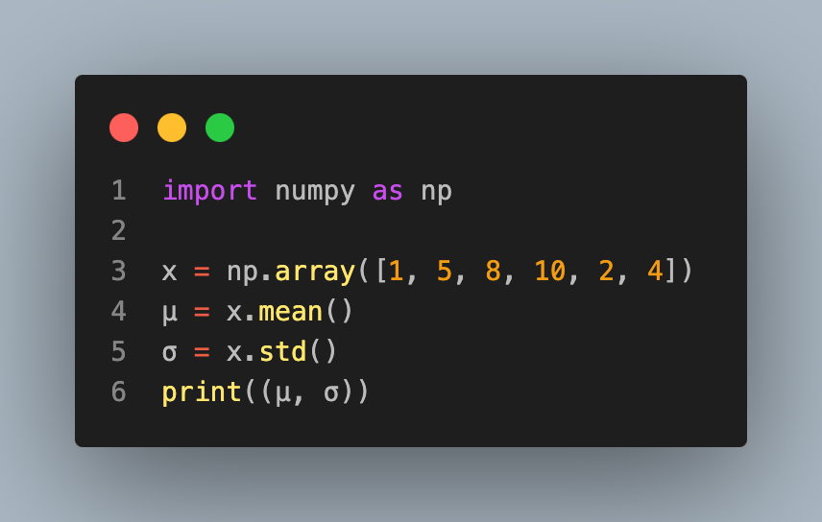
Probably don’t do this
(5.0, 3.1622776601683795)

Slide 5
Regexs
Regular expressions are simply advanced pattern matching tools.
Regular expressions represent regular characters, a, b, ..., z, A, B, ..., Z exactly like you'd think.
But, some other characters, ., +, and others are metacharacters that are used to help us match things.
A backslash, , can be used to directly reference a metacharacter, so "\+", references the character "+".
It can also be used to escape a regular character. So "\d" references the set of digits rather than the character d.
Honestly, I have to look up regular expressions every time I use them (which is about twice a year)

Slide 6
From Wikipedia
Metacharacter | Description
^ | Matches the starting position within the string.
. | Matches any single character.
[ ] | Matches a single character that is contained within the brackets.
[^ ] | Matches a single character that is not contained within the brackets.
$ | Matches the ending position of the string or the position just before a string-ending newline.
( ) | Defines a marked subexpression.
\n | Matches what the nth marked subexpression matched, where n is a digit from 1 to 9
* | Matches the preceding element zero or more times.
{m,n} | Matches the preceding element at least m and not more than n times.

Slide 7
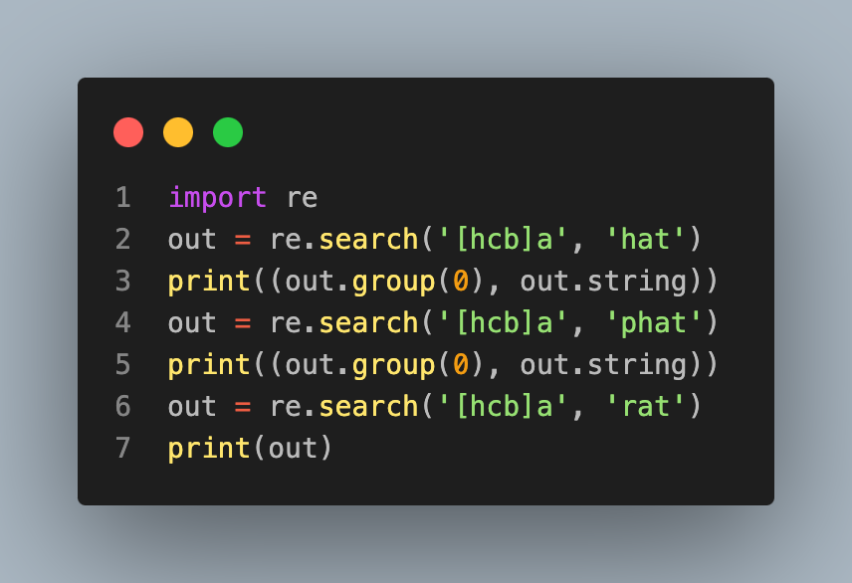
Example
('ha', 'hat’)
('ha', 'phat’)
None

Slide 8
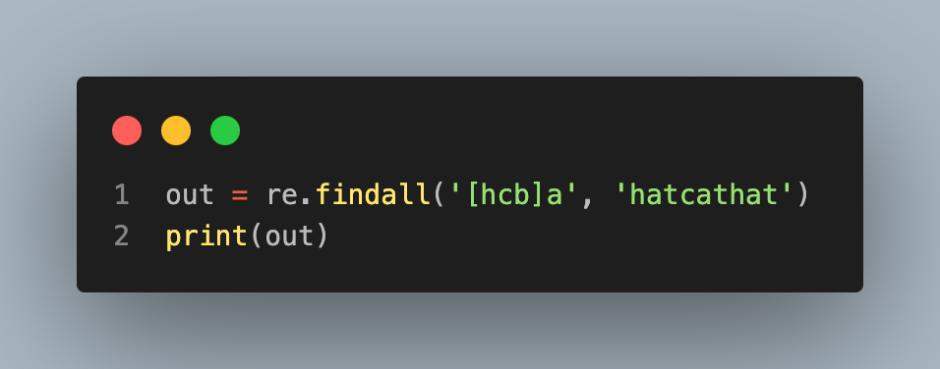
Example
['ha', 'ca', 'ha']

Slide 9
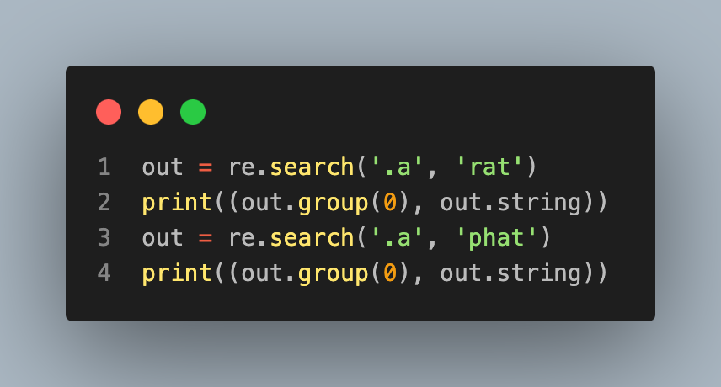
Using “.” to match any letter
('ra', 'rat')
('ha', 'phat')

Slide 10
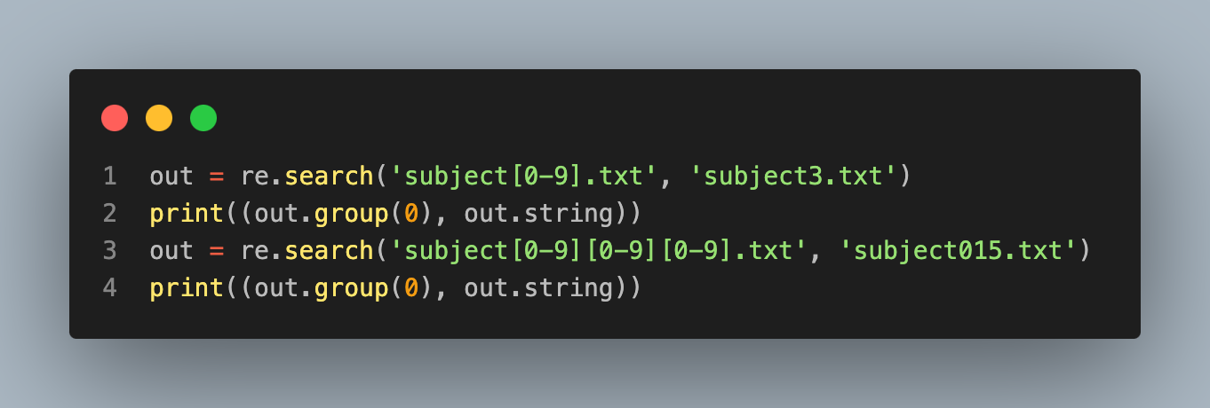
('subject3.txt', 'subject3.txt')
('subject015.txt', 'subject015.txt')

Slide 11
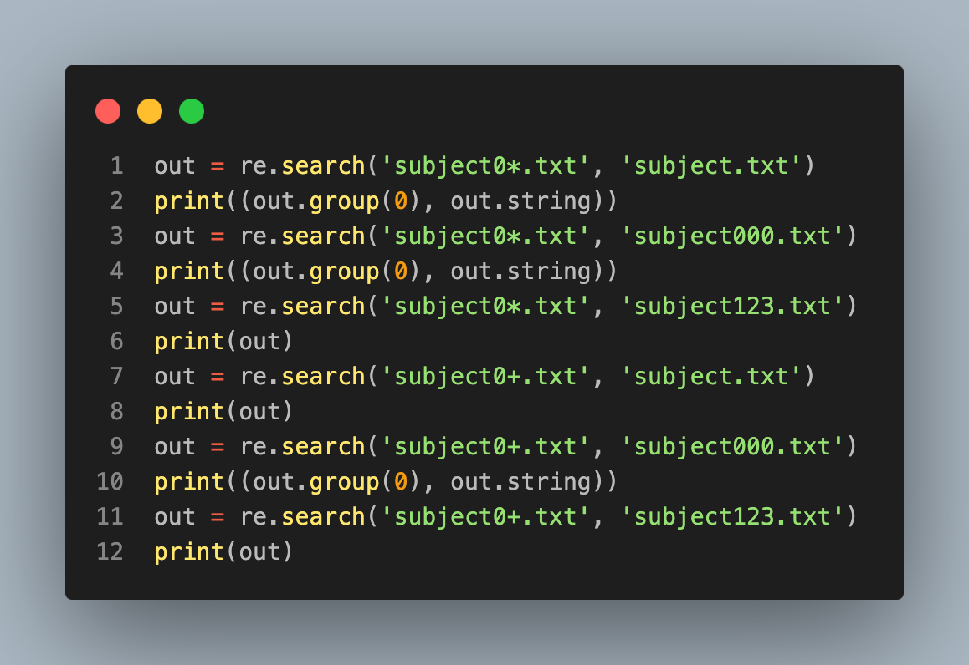
'CHARACTER*' will match any number of the character, including 0, whereas `CHARACTER+` matches one or more times.
('subject.txt', 'subject.txt’)
('subject000.txt', 'subject000.txt’)
None
None
('subject000.txt', 'subject000.txt’)
None

Slide 12
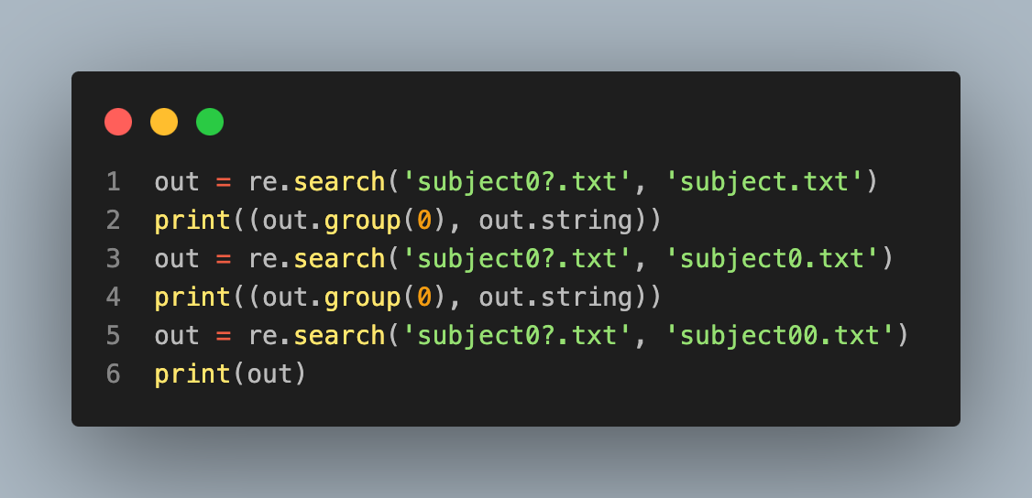
`CHARACTER?` matches one or zero times.
('subject.txt', 'subject.txt’)
('subject0.txt', 'subject0.txt’)
None

Slide 13
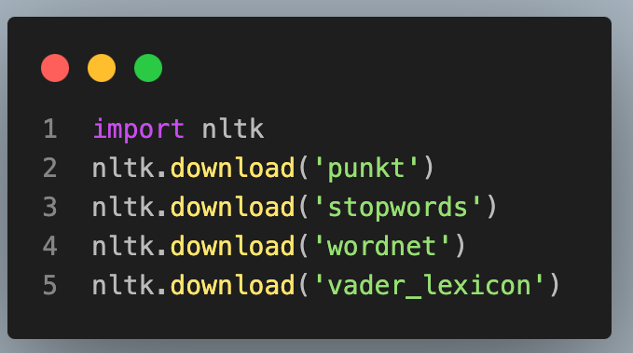
NLTK
NLTK is an important python package for language processing (natural language toolkit)
You load nltk then download the helper dictionaries that you need
[nltk_data] Downloading package punkt to /root/nltk_data...
[nltk_data] Package punkt is already up-to-date!
[nltk_data] Downloading package stopwords to /root/nltk_data...
[nltk_data] Package stopwords is already up-to-date!
[nltk_data] Downloading package wordnet to /root/nltk_data...
[nltk_data] Package wordnet is already up-to-date!
[nltk_data] Downloading package vader_lexicon to /root/nltk_data...
[nltk_data] Package vader_lexicon is already up-to-date!
True

Slide 14
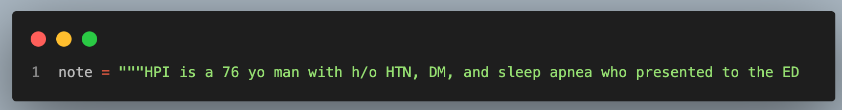
Example tokenization
text
HPI is a 76 yo man with h/o HTN, DM, and sleep apnea who presented to the ED complaining of chest pain. He states that the pain began the day before and consisted of a sharp pain that lasted around 30 seconds, followed by a dull pain that would last around 2 minutes. The pain was located over his left chest area somewhat near his shoulder. The onset of pain came while the patient was walking in his home. He did not sit and rest during the pain, but continued to do household chores. Later on in the afternoon he went to the gym where he walked 1 mile on the treadmill, rode the bike for 5 minutes, and swam in the pool. After returning from the gym he did some work out in the yard, cutting back some vines. He did not have any reoccurrences of chest pain while at the gym or later in the evening. The following morning (of his presentation to the ED) he noticed the pain as he was getting out of bed. Once again it was a dull pain, preceded by a short interval of a sharp pain. The patient did experience some tingling in his right arm after the pain ceased. He continued to have several episodes of the pain throughout the morning, so his daughter-in-law decided to take him to the ED around 12:30pm. The painful episodes did not increase in intensity or severity during this time. At the ED the patient was given nitroglycerin, which he claims helped alleviate the pain somewhat. HPI has not experienced any shortness of breath, nausea, or diaphoresis during these episodes of pain. He has never had chest pain in the past. He has been told “years ago” that he has a right bundle branch block and premature heart beats.

Slide 15
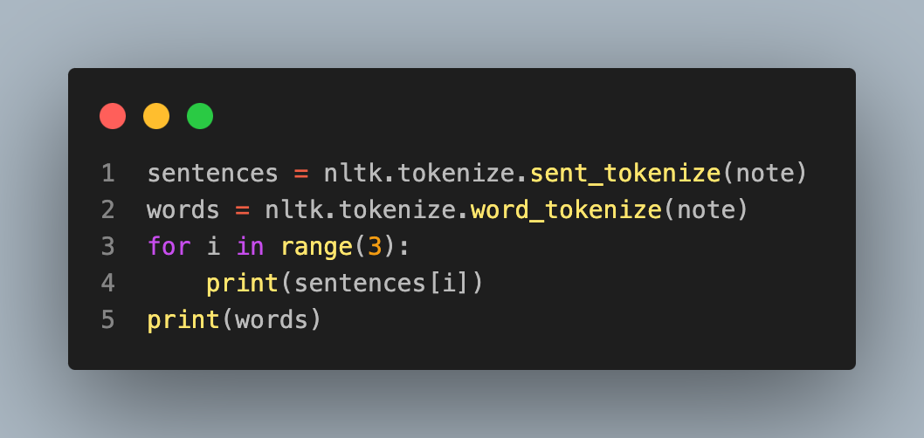
Example finding sentences and words
HPI is a 76 yo man with h/o HTN, DM, and sleep apnea who presented to the ED complaining of chest pain.
He states that the pain began the day before and consisted of a sharp pain that lasted around 30 seconds, followed by a dull pain that would last around 2 minutes.
The pain was located over his left chest area somewhat near his shoulder.
['HPI', 'is', 'a', '76', 'yo', 'man', 'with', 'h/o', 'HTN', ',', 'DM', ',', 'and', 'sleep', 'apnea', 'who', 'presented', 'to', 'the', 'ED', 'complaining', 'of', 'chest', 'pain', '.', 'He', 'states', 'that', 'the', 'pain', 'began', 'the',

Slide 16
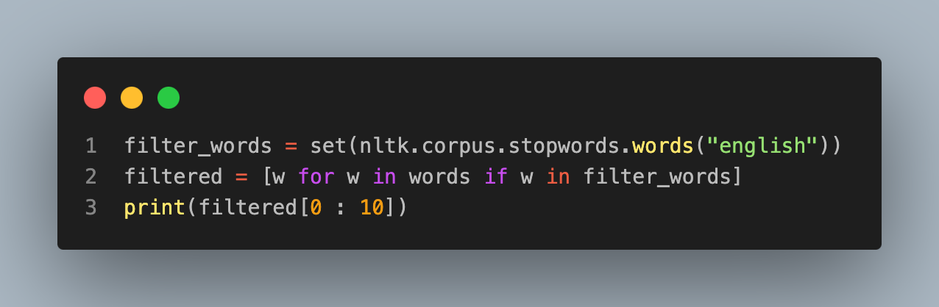
Example filtering out common English filler words
['is', 'a', 'with', 'and', 'who', 'to', 'the', 'of', 'that', 'the']

Slide 17
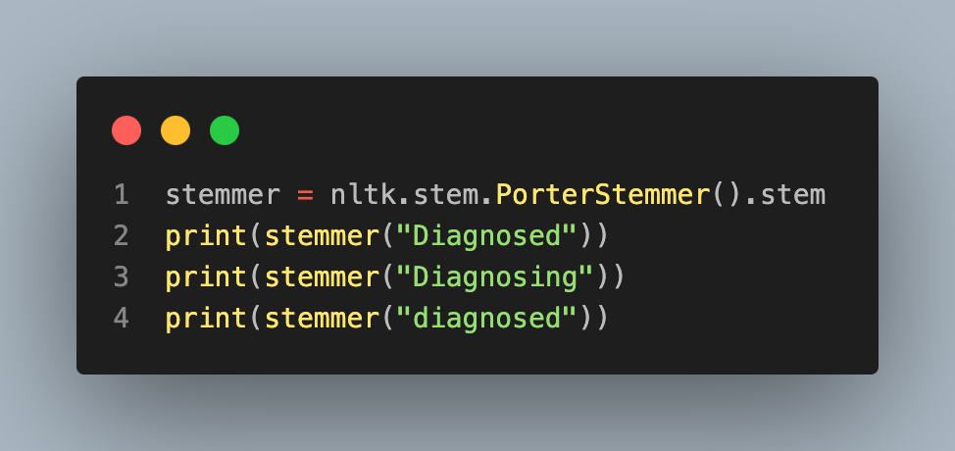
Reducing words to their stem
diagnos
diagnos
diagnos

Slide 18
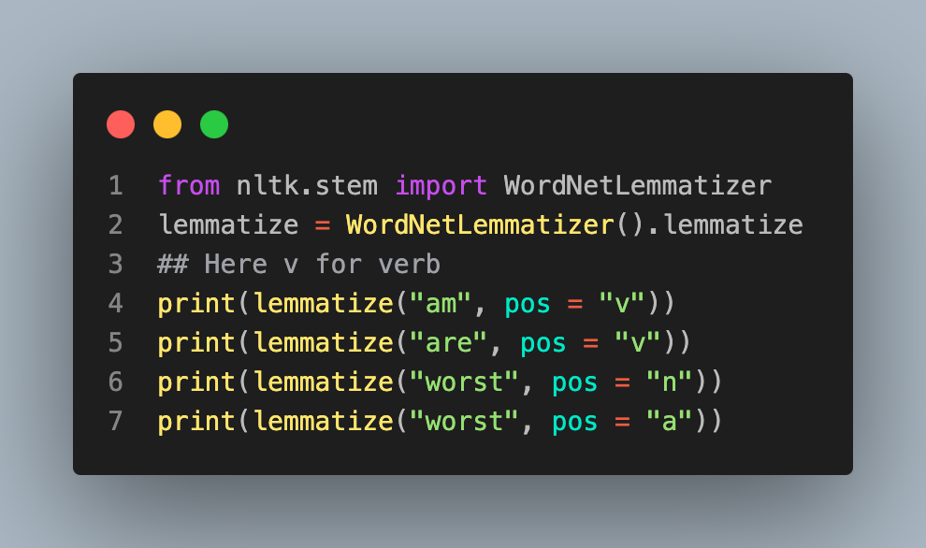
Lemmatizer reduces a word to an underlying meaning
be
be
worst
bad

Slide 19
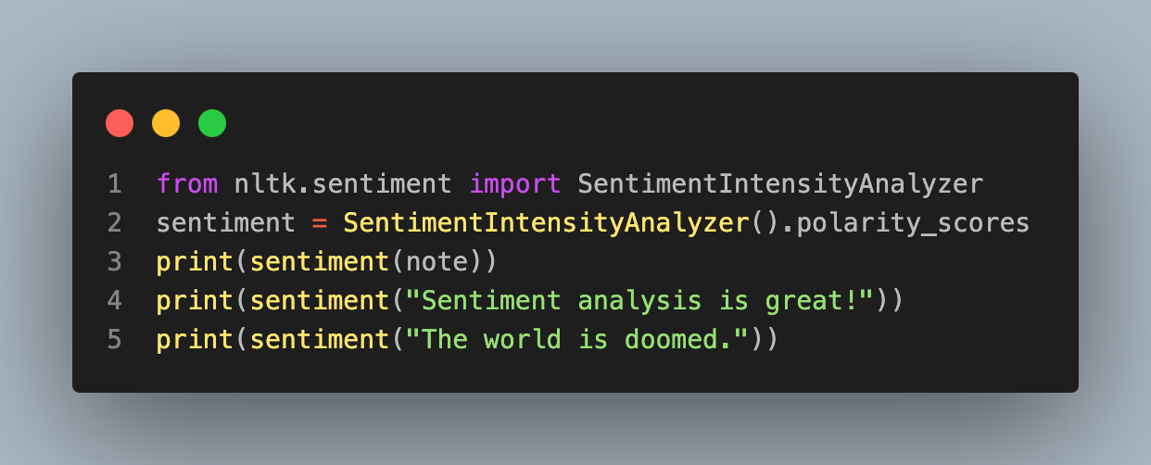
Sentiment
{'neg': 0.214, 'neu': 0.786, 'pos': 0.0, 'compound': -0.9971}
{'neg': 0.0, 'neu': 0.406, 'pos': 0.594, 'compound': 0.6588}
{'neg': 0.583, 'neu': 0.417, 'pos': 0.0, 'compound': -0.6369}

